Slide 1



Automatic Cheque Detection
PCSE24-39
Submitted by :
Rishabh Jaiswal(2000290100114)
Yogesh Kumar Singh(2000290100199)
Prerna Choudhary (2000290100105)
Under guidance of:
Ms. Bharti Chugh

Slide 2
OUTLINE
Introduction
Key Components Used
Methodology Used
Finding & Examination
Conclusion

Slide 3
INTRODUCTION
Despite the rise of digital transactions, bank cheques remain crucial globally. Yet, manual processing is laborious, expensive, error-prone, and time-consuming. Automation is essential for efficiency and accuracy in cheque processing.
Bank cheque automation relies on disciplines like computer vision, image processing, pattern recognition, and deep learning. Each step is crucial, from gathering and processing images to extraction and recognition.
This research focuses on enhancing bank cheque verification precision by applying image processing and deep learning to segment scanned images for extracting critical information.

Slide 4
KEY COMPONENTS USED
The key components used in Computer Vision and Deep Learning are-
OCR (Optical Character Recognition)- In computer vision, OCR converts scanned text into machine-readable data, enabling automated text analysis for tasks like document processing and bank cheque verification.
SIFT (Scale-Invariant Feature Transform)- In computer vision, SIFT extracts distinctive features from images, facilitating robust object recognition and matching in various applications like image stitching and signature verification.
SVM (Support Vector Machine)- In machine learning SVM, is a powerful classification algorithm that identifies optimal hyperplanes to separate data into distinct categories, widely used in tasks like image classification and signature authentication.
CNN (Convolutional Neural Network): Deep learning model specialized in processing visual data, widely used for image classification and object detection.

Slide 5
METHODOLOGY
1. Image Acquisition
Image acquisition is the initial step in our research process.
Preprocessing procedures are essential for preparing scanned images for further analysis.
These operations ensure that images are ready for subsequent image-processing tasks.
2. Image Preprocessing
Scanned images cannot be utilized without undergoing preprocessing first.
To begin, the image is rotated using the "Date Box" as a reference point for alignment.
Noise and irrelevant data are then removed to enhance the accuracy of parameter identification.
The RGB image is converted into a monochromatic grayscale image using a designated formula.
Gaussian filtering is applied to the grayscale image to reduce noise and improve clarity.
Finally, the image is converted into a binary format to facilitate contour extraction for precise analysis.

Slide 6
Continue…
3. Segmentation for Bank Cheque Verification
Image segmentation divides critical data and identifies relevant sections of the cheque document.
This process streamlines the procedure by focusing only on necessary data.
Contour extraction and standard templates adhere to RBI proportions for segmentation.
OCR recognizes handwritten digits and typographic letters.
SIFT extracts features, while SVM classifies them for signature verification.
Operator intervention is required to verify size and standard deviations during semi-automatic segmentation.
4. CNN legal and courtesy amount identification model
We applied a Convolutional Neural Network (CNN) to interpret handwritten numbers for the courtesy amount.
For training and evaluation, we utilized the MNIST dataset for digit identification and EMNIST for English letter recognition, allocating 80% for training and 20% for testing.
To ensure accuracy, we sorted numerical digits using the Indian Place Value (IPV) system, employed transfer learning for handling variations, and verified the results against legal amounts, adhering to CTS-2010 standards.

Slide 7
Continue…
5. Signature Verification Process
Attributes were extracted and standardized from each signature image, followed by normalization to eliminate scaling, thinning, rotating, and cropping features.
Scale-Invariant Feature Transform (SIFT) was employed to extract features and outlines.
SVM classifiers utilized SIFT-derived features for signature authentication, evenly dividing genuine and fraudulent data for training and testing, ensuring cheque authenticity as per CTS-2010 standards and other country-specific criteria.

Slide 8
Continue…
Cheque leaflet form
Scan the cheque
Image preprocessing
Segmentation
Scanned
Cheque
image
Cropped and
Noise-free
Cheque leaflet
Cheque verification result
Segmented
Image
pieces
Applying OCR
Segments
having
typed
information
Extracted
information
Matching courtesy and legal amount
Applying CNN to recognize Characters and numbers
Segments
having
Handwritten
information
Classification
Amount
verification
Extracted
Info.
Applying SVM
Applying SIFT
Signature
Image
Segments
Signature
authentication
Extracted
features
Block diagram of bank cheque verification process

Slide 9
Findings and Examination
MATLAB was utilized to evaluate performance and accuracy, analyzing 114 scanned bank cheque images, predominantly from the IDRBT dataset.
A Convolutional Neural Network achieved 99.14% accuracy in identifying handwritten digits, with character recognition networks trained over 850 iterations, achieving 99.94% accuracy.
English-to-Indian place-value conversion was conducted using courtesy photos, followed by signature verification and comparison with the approved sum.
A Support Vector Machine (SVM) classifier, trained on standardized segmented images and SIFT-extracted features, achieved 98.1% accuracy, validating handwritten signatures' reliability despite forensic advancements.
Evaluation of system performance across modules and methods demonstrated success in processing printed and handwritten data, confirming signature authenticity.

Slide 10
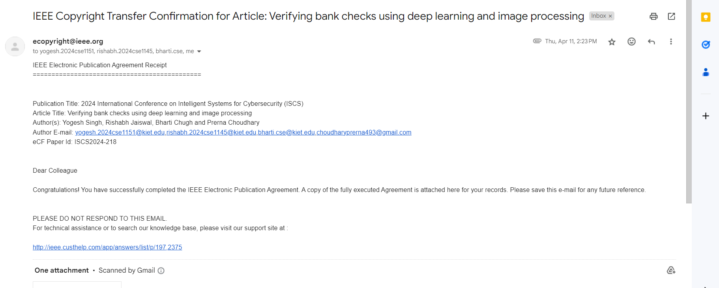
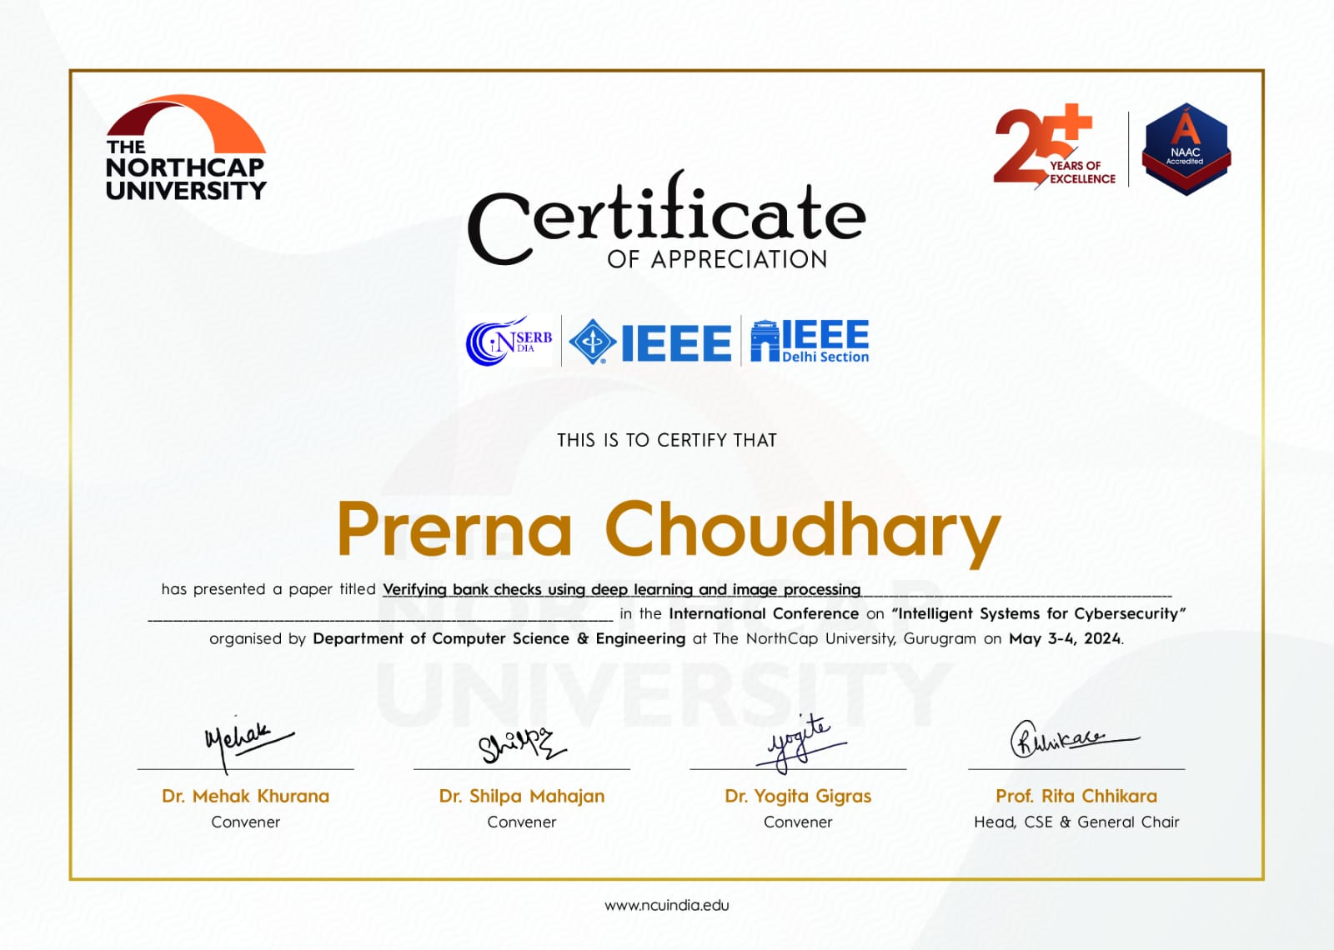
Research Paper Accepted

Slide 11
Conclusion
In conclusion, our integrated bank cheque verification system, utilizing OCR, CNN, SIFT, and SVM, streamlines cheque clearance with remarkable efficiency and accuracy. Achieving high OCR and CNN accuracy rates, along with robust signature verification through SIFT and SVM, ensures reliable processing. Banks benefit from automation, saving time and simplifying transaction tracking. With potential for multilingual adaptation, our model presents a transformative solution for cheque processing challenges.

Slide 12
References
[1] Dhanva K, Harikrishnan M, Babu PU (2018) Cheque image security enhancement in online banking. In: Second international conference on inventive communication and computational technologies (ICICCT), pp 1256–1260
[2] Singh HK, Tigga AE (2012) Impact of information technology on indian banking services. In: 1st International conference on recent advances in information technology (RAIT), pp 662–665.
[3] Wang P, Shiau CR (1972) Machine recognition of printed Chinese characters via transformation algorithms. Pattern Recognit 5(4):303–321
[4] Zramdini A, Ingold R (1998) Optical font recognition using typograph ical features. IEEE Trans Pattern Anal Mach Intell 20(8):877–882
[5] Zhu Y, Tan T, Wang Y (2002) Font recognition based on global texture analysis. IEEE Trans Pattern Anal Mach Intell 23(20):1192–1200
[6] Saenthon A, Sukkhadamrongrak N (2014) Comparison the training methods of neural network for English and Thai character recognition. In: Signal and Information Processing Association Annual Summit and conference (APSIPA), pp 1–4
[7] Ramanathan TT, Sharma D (2017) Multiple classifications using svm based multi knowledge-based system. In: International conference on advances in computing & communications, (ICACC’17), pp 307– 311.

Slide 13
Thank You

